Slide 1
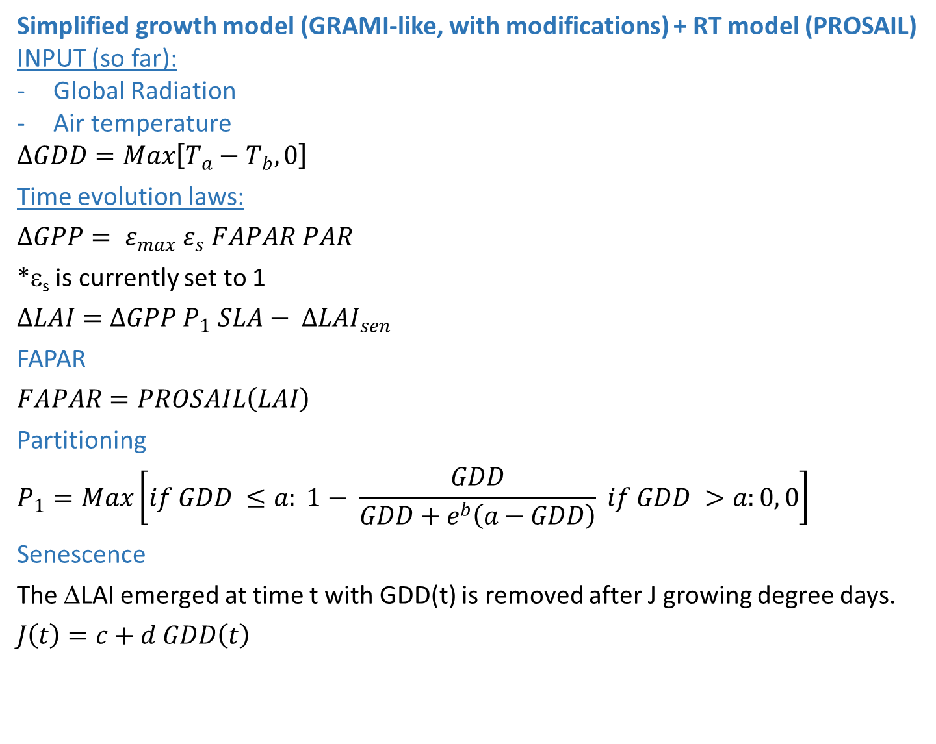
Simplified growth model (GRAMI-like, with modifications) + RT model (PROSAIL)
INPUT (so far):
Global Radiation
Air temperature
$$∆GDD=Max\left[T_{a}−T_{b},0\right]$$
Time evolution laws:
$$∆GPP= ε_{max} ε_{s} FAPAR PAR$$
*ε_{s} is currently set to 1
$$∆LAI=∆GPP P_{1} SLA− {∆LAI}_{sen}$$
FAPAR
$$FAPAR=PROSAIL\left(LAI\right)$$
Partitioning
$$P_{1}=Max\left[if GDD ≤a: 1− \frac{GDD}{GDD+e^{b}\left(a−GDD\right)} if GDD >a:0, 0\right]$$
Senescence
The ΔLAI emerged at time t with GDD(t) is removed after J growing degree days.
$$J\left(t\right)=c+d GDD\left(t\right)$$
OUTPUT (among others):
GPP
TOC ref in 400- 2500 nm range of any sensor (MODIS)
Contact: michele.meroni@jrc.ec.europa.eu

Slide 2
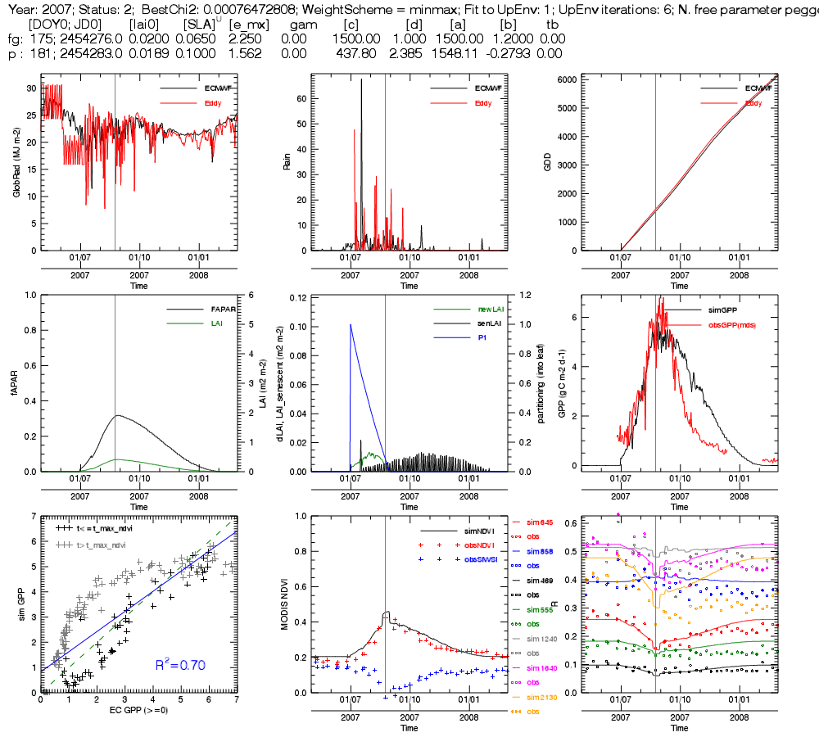
Year 2007

Slide 3
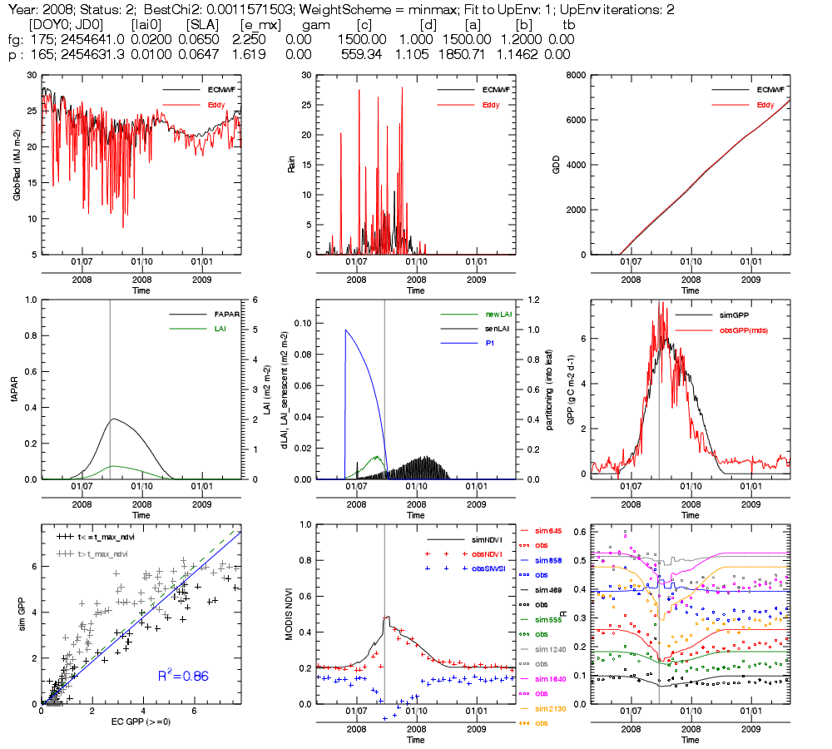
Year 2008

Slide 4
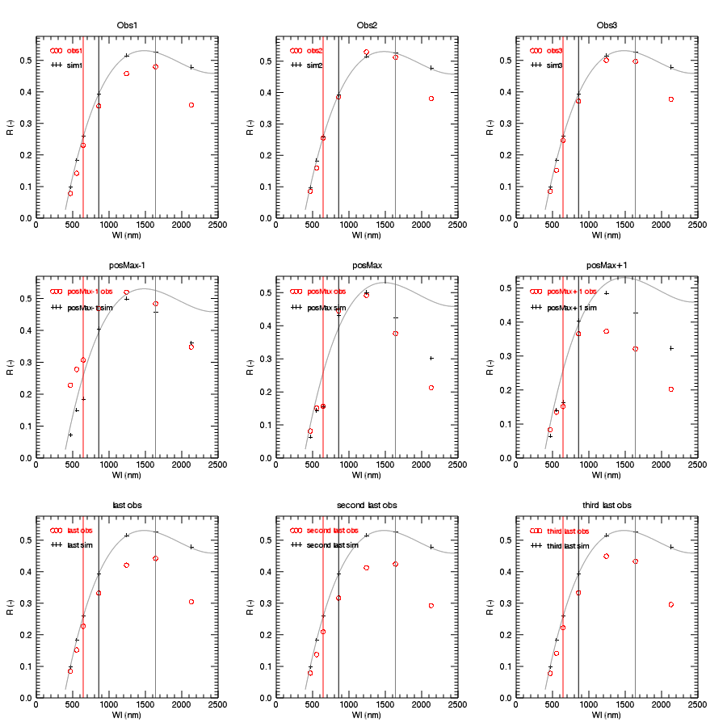
Year 2008, spectral signatures
Lower than “bare soil”

Slide 5
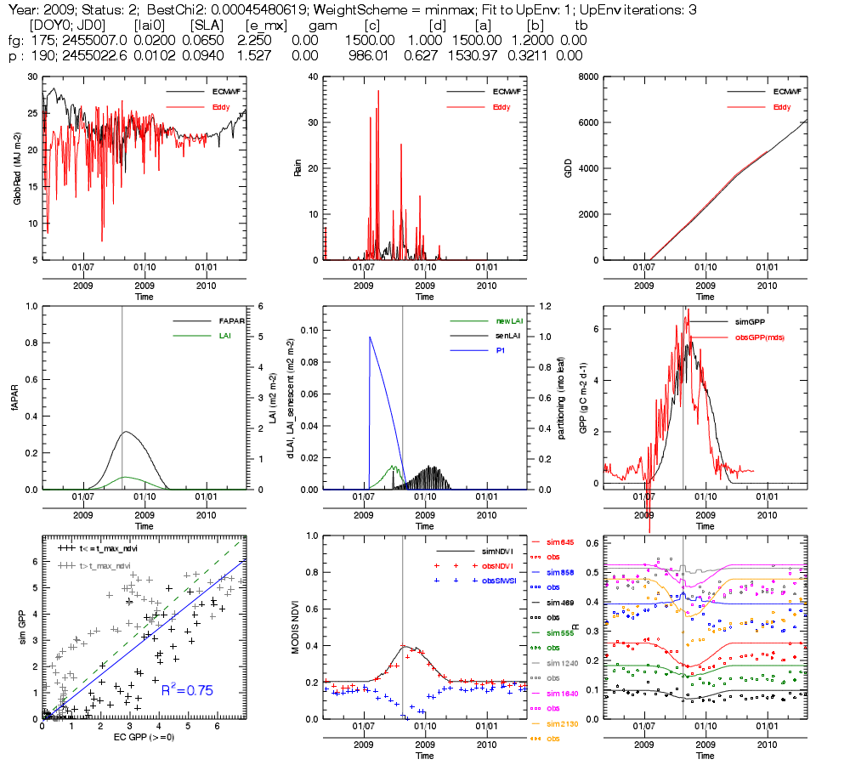
Year 2009

Slide 6
Contac of EC data: Jonas Ardö
EC data provided: EC for 2007-2009
Data needs:
LAI measurements
[Jonas:] No LAI2000 or similar field measurements available. MODIS LAI or perhaps
use the data in the field site description
Pictures along the season
[Jonas:] Pictures uploaded using sprend.com (see email)
Field spectra (400-2500 nm), including spectra of bare soil
[Jonas:] Not available, may be collected later.
Open issues:
Some very daily low tower GlobRad, is it realistic?
[Jonas:] See next slide
explanation for GPP drops in 2008-2009 after max GPP
[Jonas:] Grass browning, low amounts of available water?
GPP>0 out of the main season, what is there?
[Jonas]: Presence of trees possibly having access to water deeper soil
why NIR and SWIR (and RED to some extent) does not go back to pre-season in 2008-2009?
Is it likely that dry vegetation stays there (I am removing LAI to simulate senescence..)?
[Jonas:] The site around the flux tower is not grazed very much as this is a protected
(but not fenced) area. This means that there could be a lot of standing dead biomass during
the dry season.
Is there any disturbance that can happen @EOS (fires, others)?
[Jonas]: No… well there was fire once in the area (forgot which year it was)
Very low LAI (max about 0.45) and fapar (0.33) from my inversion, reasonable?
[Jonas]: No, max LAI should be around 1

Slide 7
Global radiation vs in coming PAR 2009 (Daily sums)

